Slide 1
BIG DATA
BY: KEVIN ALMEIDA, JOHN ADEROUNMU, ALON BUTBUL,
TIFFANY YANG, MATT MANGANEL, ARMANI WILLIS, HONG QUN XIA
MENTORED BY: NARASIM BANAVARA, CHING-SONG WEI

Slide 2

WHAT IS BIG DATA?
Large unstructured or semi-structured data sets or pieces of information
Text, Numbers, Pictures, Videos, Sounds
Require special applications to process
Analyzed computationally to reveal patterns, trends, and associations

Slide 3



REAL-WORLD EXAMPLES
Social Media (FaceBook, Twitter, Tumblr, etc.)
HealthCare Data (Cancer Research)
Weather Data (Humidity, Precipitation, etc.)
Traffic Data (Collisions, GPS locations, etc.)
Financial Data (Stock Market)

Slide 4
CHARACTERISTICS OF BIG DATA
Volume
Veracity
Variety
Big Data
Value
Velocity

Slide 5


BENEFITS AND CHALLENGES
Challenges/Issues
Privacy
Security
Costly
Benefits
Contextualized personalized recommendations
Predictions
Improvement in business processes

Slide 6
CURRENT PROJECT: NYPD VEHICLE COLLISION DATA
New York City Police Department Motor Vehicle Collision Data
Roughly three years worth of data (July 2012 – June 2015)
Estimated 607,111 records
Various conditions and factors

Slide 7
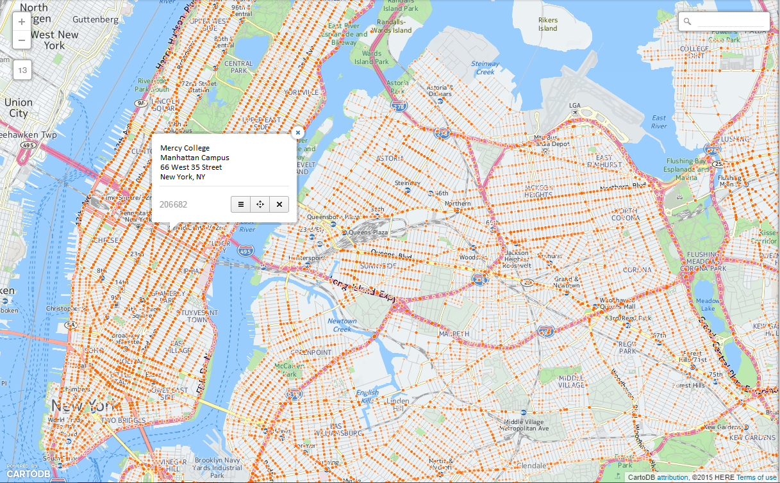

Slide 8
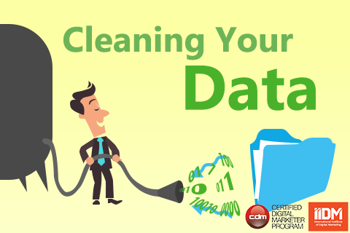
CLEANING DATA
Data cleaning is the first step in data analysis
Data came unstructured with multiple attributes
Tools need structure to analyze data
Missing or invalid information for certain attributes
Adjust formatting for programs (Words to numbers)

Slide 9


ANALYSIS TOOLS
See5 – Machine Learning Tool
Microsoft Excel – Data cleaning and analysis
RStudio – Statistical and Graphical analysis tool
CartoDB – Mapping Data
IBM BlueMix – Cloud Computing Platform for Big Data Analytics

Slide 10
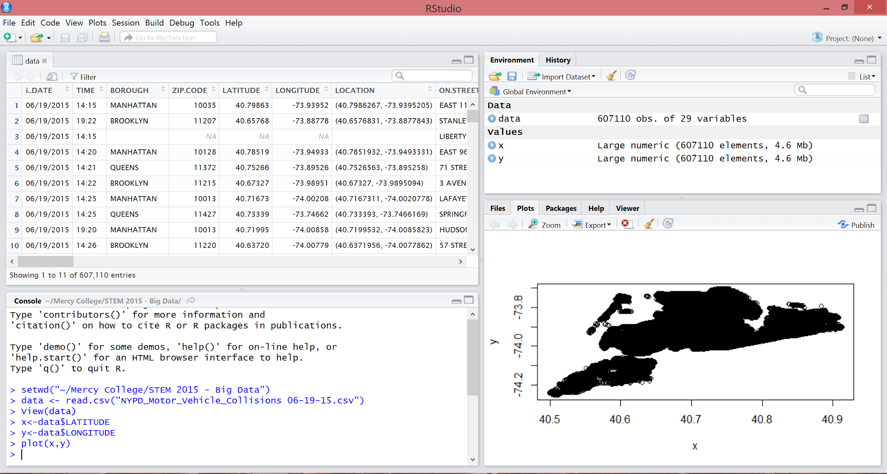
RSTUDIO SCREENSHOT

Slide 11
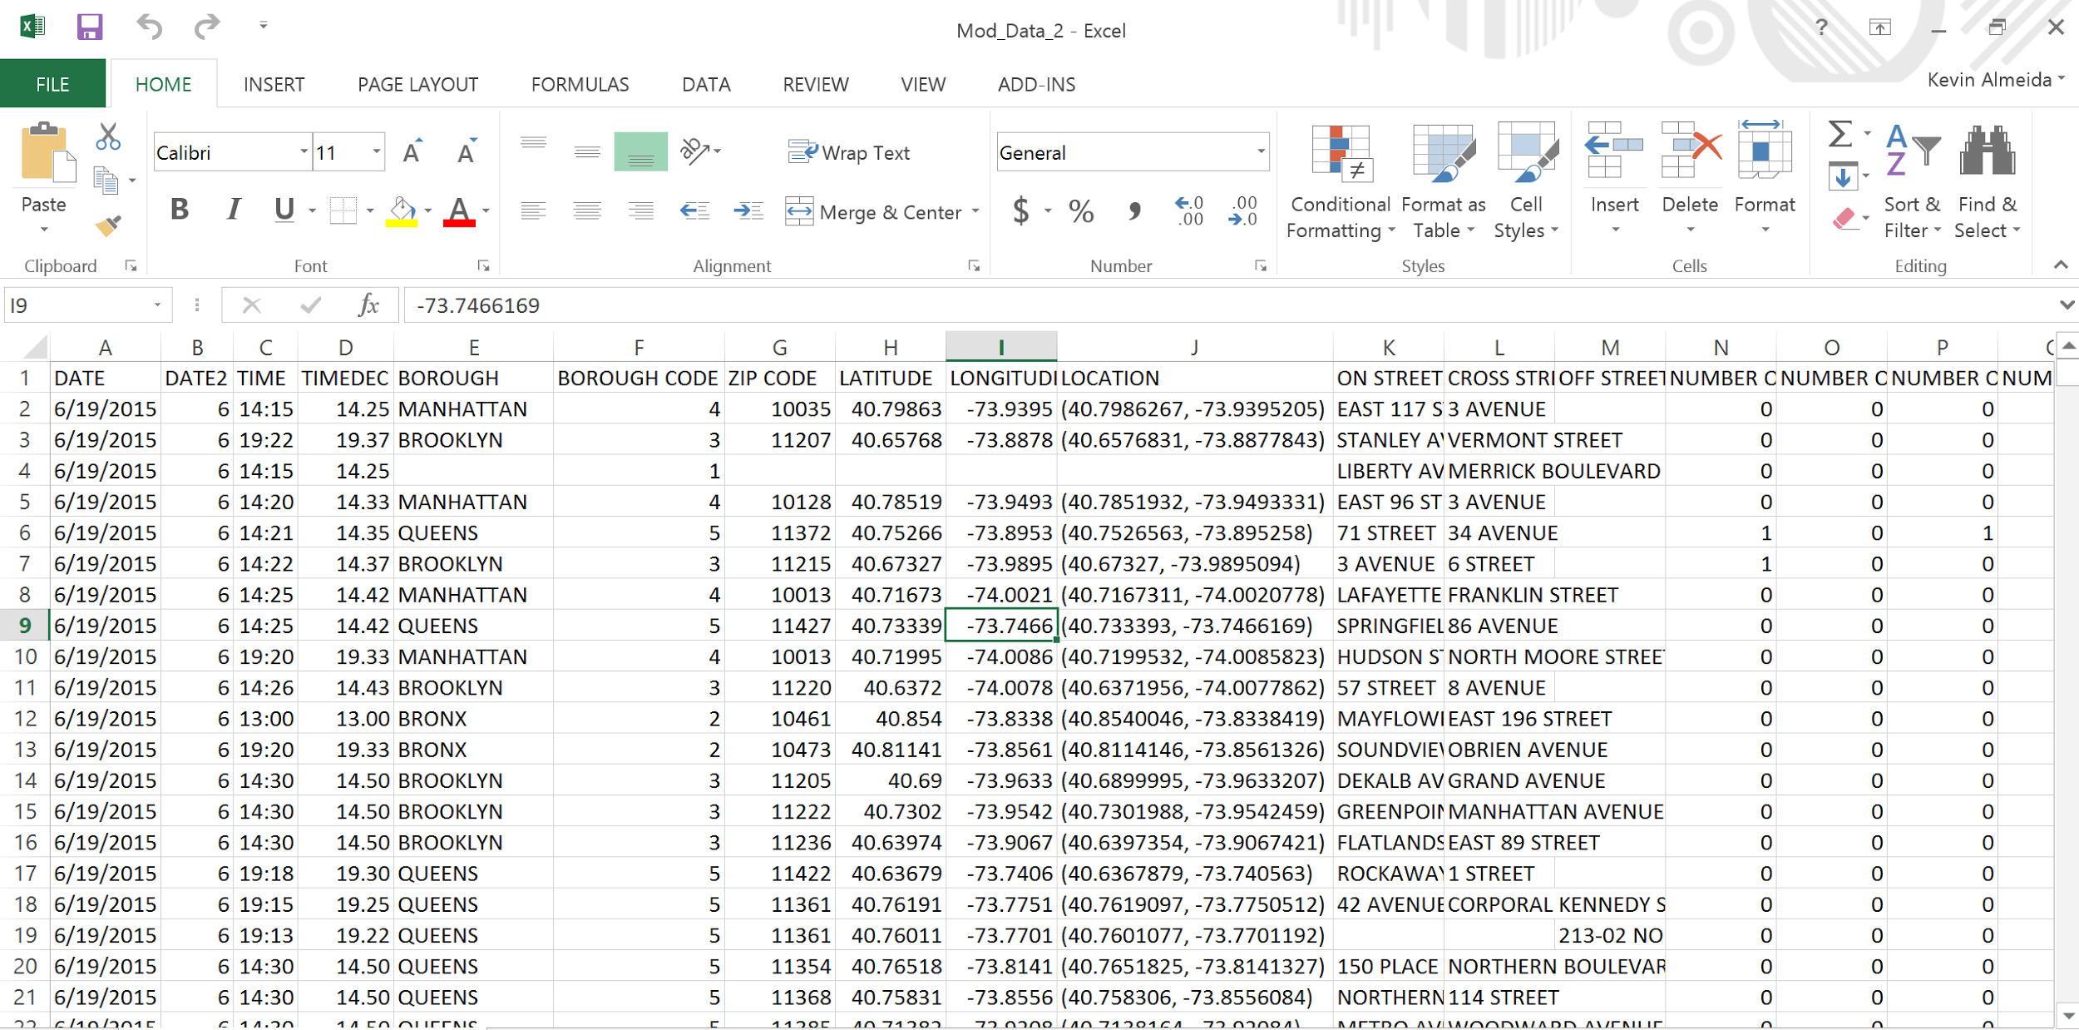
MICROSOFT EXCEL SCREENSHOT

Slide 12
ANALYSIS OF DATA
Time VS Injured or Killed
Day VS Injured or Killed
Day VS Collisions
Time VS Collisions
Contributing factor VS Collisions
Contributing factor VS Injured
Contributing factor VS Killed
Vehicle Type VS Collisions
Vehicle Type VS Injured
Vehicle Type VS Killed
Borough VS Collisions
Borough Type VS Injured
Borough Type VS Killed
Zip code VS Collisions
Zip code VS Injured
Zip code Type VS Killed
Latitude and Longitude VS Collisions
Latitude and Longitude VS Injured
Latitude and Longitude VS Killed

Slide 13
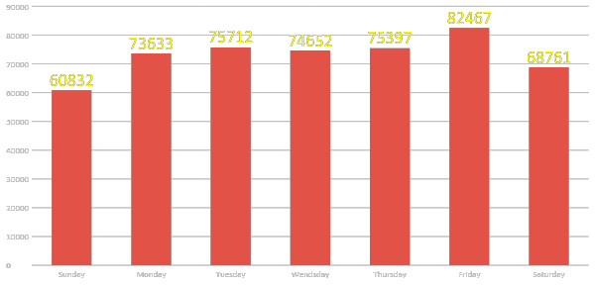
WEEKDAY VS COLLISIONS RESULTS

Slide 14
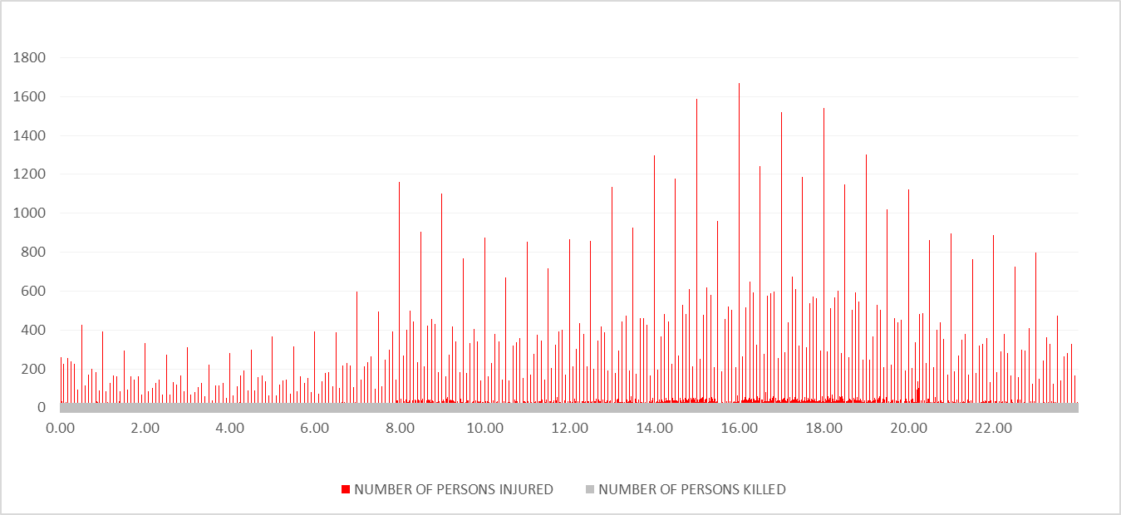
TIME VS INJURED AND KILLED

Slide 15
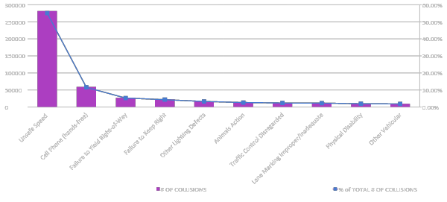
TOP 10 FACTORS FOR COLLISIONS

Slide 16
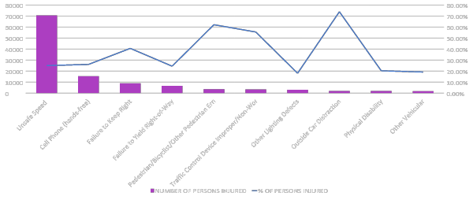
TOP 10 FACTORS FOR PERSONS INJURED

Slide 17
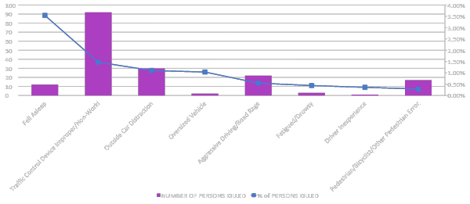
RESULTS: TOP 10 FACTORS FOR PERSONS KILLED

Slide 18

LIMITATIONS
Lack of variety
Confidential Data
Other/Missing Data
Age
Speed
Gender
Driving Experience
Weather
Road Conditions

Slide 19

FUTURE RESEARCH/ACTIVITY
CartoDB to create clusters in areas of large amounts of collisions
GPS app to alert drivers to dangerous driving areas
Publish paper on results

